Slide 1
MIS547
Cloud Computing

Slide 2
Lecture 20: MLOps

Slide 3
What do we mean by MLOps?

Slide 4
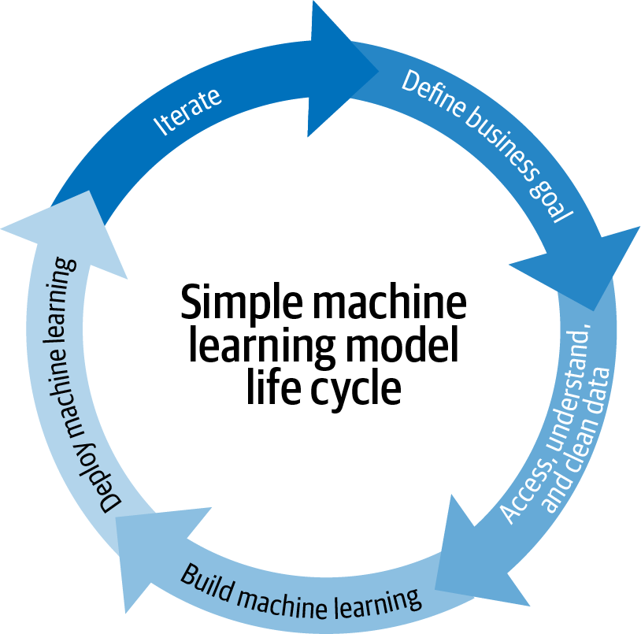
MLOps
The standardization and streamlining of machine learning lifecycle management
Source: Introducing MLOps

Slide 5
The Machine Learning Lifecycle

Slide 6
AI/ML Lifecycle
RESEARCH QUESTION
What do we need to classify? What do we need to predict?
DATA COLLECTION & PREPARATION
Cleaning, preprocessing, pipelining
MONITORING & MAINTENANCE
Monitoring the model’s performance, detecting drift, etc.
EXPERIMENTATION & EVALUATION
Building models, training & testing, evaluation metrics
SERVING & INFERENCE
Using the model’s learned weights/ parameters to predict the class of incoming (unseen) data
MODEL DEPLOYMENT
Deploying the model in a production system; determining how often the model will be retrained, etc.

Slide 7
The AI/ML Lifecycle & Roles
Domain expert + Data Scientist
Data engineer + Data Scientist
Data Scientist
Software Engineer + SRE
Software Engineer + SRE
Observability + Data Scientist
Research Question
Data Collection & Preprocessing
Experimentation & Evaluation
Model Deployment
Model Serving & Inference
Monitoring & Maintenance
Driven by domain experts
Cleaning, feature engineering
Experimentation, evaluation, hyperparameter tuning, etc.
Persist model weights
Streaming/ online data
Batch data
Ongoing evaluation

Slide 8
Key Tasks in each Stage

Slide 9
Key Tasks in Each Stage
Stage 1: Research Questions
Stage 2: Data Collection & Preprocessing
Stage 3: Experimentation & Evaluation
Stage 4: Model Deployment
Stage 5: Serving & Inference
Stage 6: Monitoring & Maintenance

Slide 10
Stage 1: Research question(s)
How can we prevent fraudulent actors from onboarding onto our platform/product?
How can we better identify cancerous cells from medical imaging scans?
How can we predict population outcomes when creating housing policies?
How can we forecast revenue growth in Q4 given previous year’s quarterly sales?
Research questions are generally defined by domain experts or business goals
Example research questions include…

Slide 11
Stage 2: Data Collection & Preprocessing Tasks
01
Identify existing datasets to use
Collect new data if needed
Create ETL pipelines
Identify appropriate databases & schemas
Data Collection & Storage
02
Understand the dataset as fully as possible
Summary statistics
Identify variables, cardinality, usability (% data populated)
Exploratory Data Analysis
03
Convert data types (int to float, etc.)
Impute missing values
Remove outliers
Data Cleaning
04
Transform data to be usable by an ML model
Feature extraction
Feature selection
Feature Engineering

Slide 12
Stage 2: Data Collection & Preprocessing Tasks
01
Identify existing datasets to use
Collect new data if needed
Create ETL pipelines
Identify appropriate databases & schemas
Data Collection & Storage
Data Collection
Open Source
Data Repositories
Internal Data
Web Scraping
Extract, Transform, Load (ETL)
Pipelines
dbt
Airflow
Data Storage
Databases
Warehouses
Data Lakes

Slide 13
Stage 2: Data Collection & Preprocessing Tasks
02
Understand the dataset as fully as possible
Summary statistics
Identify variables, cardinality, usability (% data populated)
Exploratory Data Analysis
Summary Statistics
# Observations
# Classes
# Variables
Variables
Definitions
% populated
Cardinality
Provenance
Visualization
Histograms
Scatter plots
Dimensionality reduction

Slide 14
Stage 2: Data Collection & Preprocessing Tasks
03
Convert data types (int to float, etc.)
Impute missing values
Remove outliers
Data Cleaning
Convert Data Types
int → float
datetime normalization
casing
encoding
Impute Missing Values
median
mean
previous value
None/ NA/ 0
Remove Outliers
Use EDA step to understand outliers
Are outliers meaningful?
The kind of data is very important in this step! Time series data and text data need to be handled very differently.

Slide 15
Stage 2: Data Collection & Preprocessing Tasks
04
Transform data to be usable by an ML model
Feature extraction
Feature selection
Feature Engineering
Transform data
Categorical data
One-hot encoding
Label encoding
Text data
Embeddings
Time series
Remove seasonality
Feature extraction
Image data
Convert to matrices
Combine variables
Time since x
Scaling features
Feature Selection
Statistical tests
Feature correlation
Variance inflation factor
Data transforms and feature extraction processes need to be persisted for inference stage!

Slide 16
Considerations for Data Collection & Preprocessing
Data Collection & Ingestion
Warehouse and Data Lake maintenance
NoSQL databases are becoming more popular (esp. vector databases)
EDA
This step does not necessarily need to be repeated after it’s first performed. However, it is a critical step before moving on to cleaning & preprocessing
Cleaning
Once the key steps in data cleaning are identified for the dataset, this can be fully automated (in most cases)
Preprocessing
Preprocessing could be its own microservice, as it needs to be used both for training and also inference
If the preprocessing step involves scaling features or referring to a label-encoded dictionary, these values need to be available at inference as well.

Slide 17
Stage 3: Experimentation & Evaluation
Select the model
Build the model
Train the model
Test & evaluate the model
Tune the model hyperparameters
Model family
Model task
Model architecture decisions
Model libraries: Pytorch, sckit-learn, Tensorflow, Keras
Input & output dimensions
Multi-stage, parallelism, etc.
Determine Hardware requirements
GPU, memory, disk
Persist model weights & parameters
Evaluation criteria depend on the task
Test the model on unseen data
Persist results for benchmarking & comparison
Determine if model performance can be improved by tuning hyperparameters

Slide 18
Stage 3: Experimentation & Evaluation
Select the model
1. Determine what model family is appropriate for the data
(Supervised, unsupervised, semi-supervised, reinforcement, etc.)
2. Determine what task you are trying to achieve
(Classification, regression, modeling, forecasting)
3. Determine what model architecture is appropriate for the data and the task (and environment)
(Deep learning, statistical ML, generative AI)

Slide 19
Stage 3: Experimentation & Evaluation
Select the model
Build the model
1. What libraries will you use?
- Pytorch, scikit-learn, Tensorflow, Keras, etc.
2. How will your preprocessed data be input to the model?
- Input and output dimensions
- Determine if additional processing needs to happen internally in the model
3. Other specifics of model creation
- Optimization & loss functions; drop-out layers, max pooling, etc.
4. How will your model’s weights be persisted?

Slide 20
Stage 3: Experimentation & Evaluation
Select the model
Build the model
Train the model
1. Containerize your model training code & train on remote machine
2. What are your hardware requirements?
- Not just GPU! Memory is intensive, disk space can be intensive, bandwidth can be intensive when reading data
3. How will you persist & access the trained model?
4. Checkpoints during training

Slide 21
Stage 3: Experimentation & Evaluation
Select the model
Build the model
Train the model
Test & evaluate the model
Evaluation criteria are determined by the task you set forth for model training.
How will you access evaluation criteria?
Test data needs to be preprocessed using the same processes defined when you’re feature engineering and building your model
Evaluation criteria are only one part of model evaluation; case studies and real-world trials are equally important.
Evaluate feature importances; if engineered features have low importance, can you prune them?

Slide 22
Stage 3: Experimentation & Evaluation
Select the model
Build the model
Train the model
Test & evaluate the model
Tune the model hyperparameters
Hyperparameters are variables external to the model. These include things like:
Learning rate
Choice of optimizer
Number of clusters
Cut-off threshold for decision boundaries
We re-run experiments (build → train → evaluate) and record results.
Where are results recorded? How are experiments defined?
Conduct t-tests to determine statistical significance

Slide 23
Key MLOps Considerations Model Experimentation & Evaluation
How and where will the model training be conducted?
What automated pipelines can you use for model training?
How will the model training service access required data?
How will you know exactly what data was trained on and that it was preprocessed correctly?
Data catalogs

Slide 24
Stage 3: Experimentation & Evaluation
If conducting research, there’s another step in Stage 3, which is benchmarking the model against existing state-of-the-art (SOTA) models.
Evaluation against these models requires additional tests, such as t-tests to determine p-values and test for statistical significance.
When exploring which features are the most important for a model, we may also wish to add features or remove features; the results of these experiments should be recorded as well!

Slide 25
Stage 4: Model Deployment (Model Ops)

Slide 26
Stage 5: Model Deployment (Model Ops)
Model Artifacts
Deployment Considerations
Model Ops
Model assets
Retraining & compute requirements, sidecars, audit tables
Ensuring the trained model artifacts are persisted, updated, and available for other services.

Slide 27
Stage 5: Model Deployment (Model Ops)
Training Checkpoints
Serialized to disk
Persist in additional cloud storage
The trained model
Serialized to disk
Persist in a location that’s readable by inference service
Model signing
Trained model hyperparameters
Record to audit table
Training data catalog
Creating hashes of your training data
Training evaluation metrics
Record to audit table
Feature importances
Record to audit table
Model Artifacts
Model assets

Slide 28
Stage 4: Model Deployment (Model Ops)
Automated pipelines for model deployment
How often will the model be retrained?
Compute requirements for retraining
Incremental training/ fine tuning
Data persistence
Encoded dictionaries, data enrichment, caching
Will the training service need to have other persistence requirements
Side cars
Temporary data stores between model training runs
Deployment Considerations
Retraining & compute requirements, sidecars, audit tables

Slide 29
Key MLOps Considerations in Model Deployment (Model Ops)
Availability of data structures and model artifacts created during model training
Persisting a record of training data (and verifying training data through hashing)
Securely reading and writing trained model (can you write to disk?)
Hardware requirements
Are sidecars needed? If so, are they allowed in your cluster?
Container resource constraints may need to be disabled
So many audit tables
Model version, model evaluation results, feature importances, data catalog + hash, signing model

Slide 30
Stage 5: Model Serving & Inference

Slide 31
Stage 5: Model Serving & Inference
Streaming
Batch
One-Off
Streaming or Online Inference Considerations
Batch Inference Considerations
One-off Inference Considerations

Slide 32
Stage 5: Model Serving & Inference
Preprocessing:
Needs to be minimal or extremely lightweight
Architecture:
May need to use Kafka
Bandwidth & Latency:
Bandwidth will likely be very high; latency needs to be extremely low
Scalability:
Requires elastic infrastructure
Data Retrieval:
Should be minimal or none
Costs:
Mostly incurred from calling service
Streaming
Streaming or Online Inference Considerations
Preprocessing
Architecture
Bandwidth Requirements
Latency
Scalability
Data retrieval
Costs

Slide 33
Stage 5: Model Serving & Inference
Preprocessing:
Low limitations for preprocessing
Architecture:
Highly flexible architecture
Bandwidth & Latency:
Bandwidth can be high; latency is less of a concern
Scalability:
May need to elastically scale
Data Retrieval:
Can utilize extensive data retrieval without much impact
Costs:
Will be more predictable than streaming/online
Batch
Batch Inference Considerations
Preprocessing
Architecture
Bandwidth Requirements
Latency
Scalability
Data retrieval
Costs

Slide 34
Stage 5: Model Serving & Inference
Preprocessing:
Do you need to persist preprocessing algorithms from model training stage?
Architecture:
What architecture will best suit your inference needs?
Bandwidth & Latency:
Will latency impact the effectiveness of your product?
Scalability:
Will your inference endpoint need to scale?
Data Retrieval
Will inferencing depend on other data retrieval?
Costs:
What will it cost per inference request?
One-Off
One-off Inference Considerations
Preprocessing
Architecture
Bandwidth Requirements
Latency
Scalability
Data retrieval
Costs

Slide 35
Key MLOps Considerations: Model Serving & Inference
Streaming/online data, batch data, and one-off inference will all have different requirements
Inference service needs to be able to pass the same data as model training service
Inference service needs to be able to access the same preprocessing and cleaning processes as the training service
Endpoint availability is a top concern during inference
Bandwidth and latency need to be considered when creating inference service
Costs can be unpredictable
Data retrieval needs should be considered
Model decisions need to be recorded to an audit table

Slide 36
Stage 6: Monitoring & Maintenance
(ML Observability)

Slide 37
Stage 6: Monitoring & Maintenance (ML Observability)
Performance analysis
Regularly revisit metrics used in evaluation to determine if model performance has degraded
Data quality
Identify hard failures within data pipelines between training and production; monitor for cardinality shifts, missing data, data type mismatch, out-of-range
Explainability
Feature importances across training, validation, and production envs. Introspect a model, build confidence, continuously improve ML models
Drift
Monitor for a change in distribution over time, measured for model inputs, outputs, and actuals of a model.
Identify if models have grown stale, data quality issues, or adversarial inputs

Slide 38
Stage 6: Monitoring & Maintenance (ML Observability)
Alerting
Security
Periodic re-evaluation

Slide 39
The Roles Behind the ML Lifecycle

Slide 40
The AI/ML Lifecycle & Roles
Domain expert + Data Scientist
Data engineer + Data Scientist
Data Scientist
Software Engineer + SRE
Software Engineer + SRE
Observability + Data Scientist
Research Question
Data Collection & Preprocessing
Experimentation & Evaluation
Model Deployment
Model Serving & Inference
Monitoring & Maintenance
Driven by domain experts
Cleaning, feature engineering
Experimentation, evaluation, hyperparameter tuning, etc.
Persist model weights
Streaming/ online data
Batch data
Ongoing evaluation

Slide 41
The Data Science Discipline: What We’re Trained to Do
Data engineer + Data Scientist
Data Scientist
Observability + Data Scientist
Data Collection & Preprocessing
Experimentation & Evaluation
Monitoring & Maintenance
Cleaning, feature engineering
Experimentation, evaluation, hyperparameter tuning, etc.
Ongoing evaluation

Slide 42
The Data Science Discipline: What We’re Actually Doing
Domain expert + Data Scientist
Data engineer + Data Scientist
Data Scientist
Software Engineer + SRE
Software Engineer + SRE
Observability + Data Scientist
Research Question
Data Collection & Preprocessing
Experimentation & Evaluation
Model Deployment
Model Serving & Inference
Monitoring & Maintenance
Driven by domain experts
Cleaning, feature engineering
Experimentation, evaluation, hyperparameter tuning, etc.
Persist model weights
Streaming/ online data
Batch data
Ongoing evaluation

Slide 43
LAND ACKNOWLEDGEMENT STATEMENT
We respectfully acknowledge the University of Arizona is on the land and territories of Indigenous peoples. Today, Arizona is home to 22 federally-recognized tribes, with Tucson being home to the O’odham and the Yacqui. Committed to diversity and inclusion, the University strives to build sustainable relationships with sovereign Native Nations and Indigenous communities through education offerings, partnerships, and community service.

Slide 44
Admin
Assignment 10 Due Sunday
01
Group Project Feedback
03
Quiz 10 Due Sunday at Midnight
02

Slide 45
MLOps Challenges
Deploying software code into production is fundamentally different than deploying machine learning models into production.
Data is always changing
Model availability
Model quality, accuracy, fairness
Specialized talent
ML modeling relies almost entirely on open source

